Slide 1
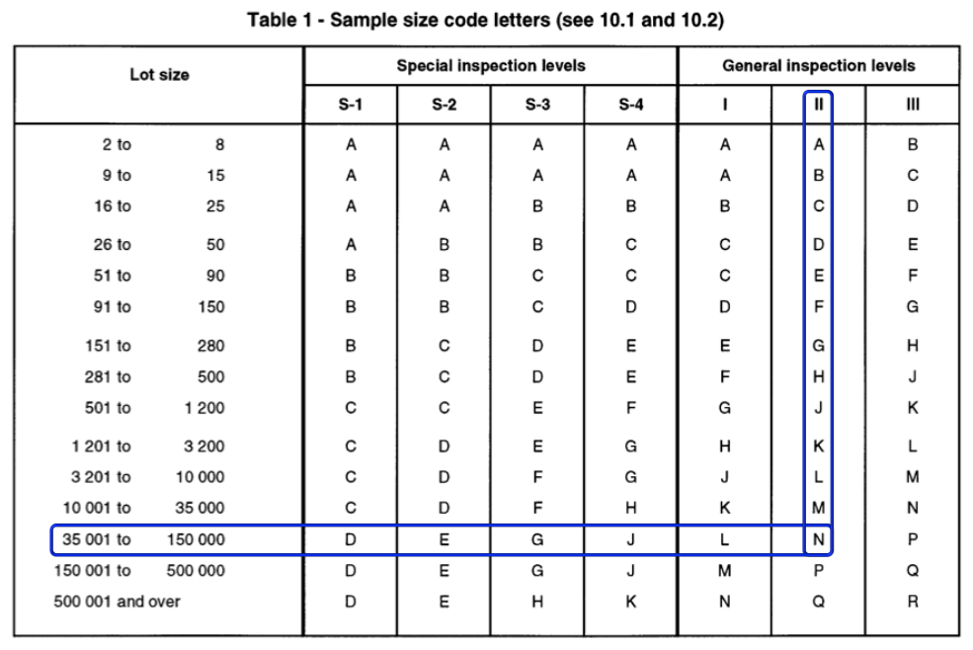
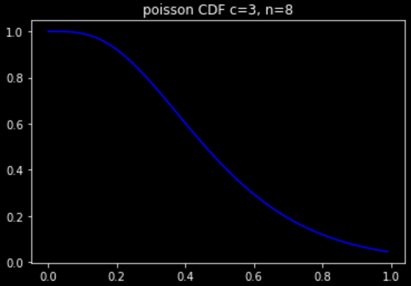

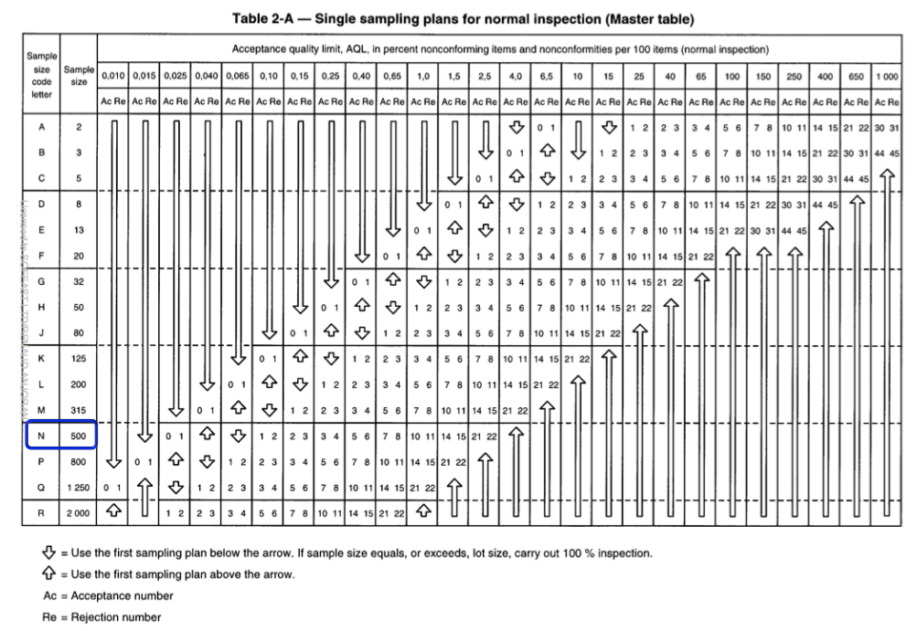
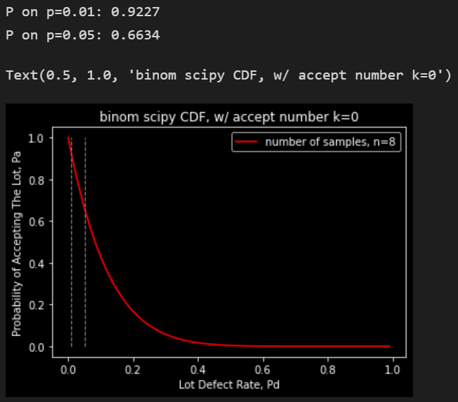

ANSI Tables
OC Curve

Slide 2
There are three methods to calculate the probability of acceptance:
Hyper-geometric
Binomial
Poisson
distribution methods.
(https://accendoreliability.com/oc-curve-with-binomial-method/)

Slide 3
Binomial

Slide 4
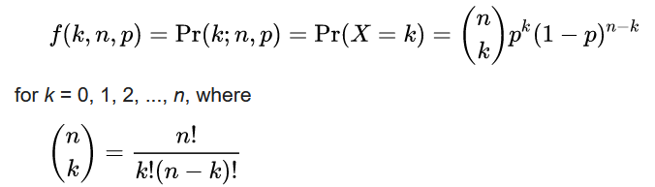
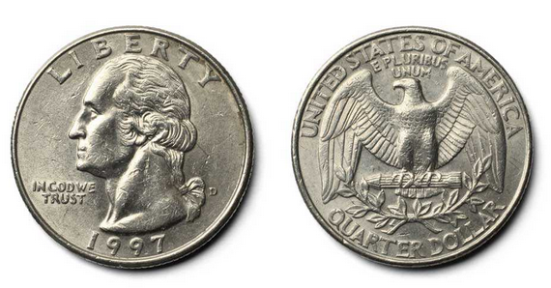

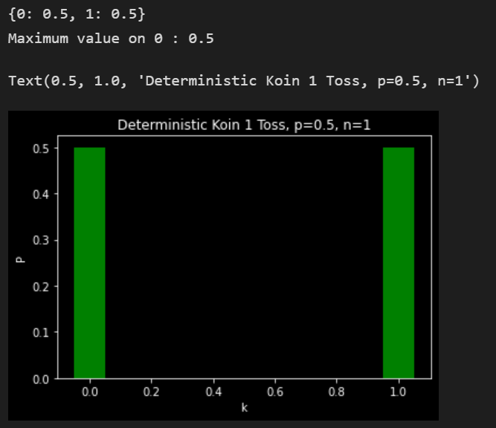
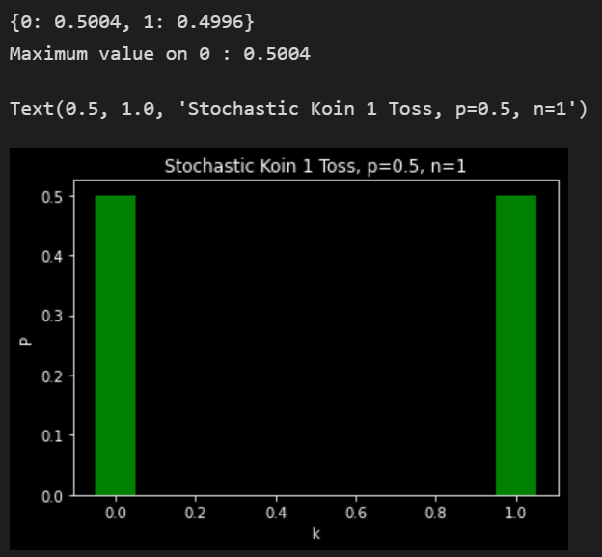
Binomial
Probability Mass Function
number_s=k, trials=n, probability_s=p
Variasi Exactly Peluang Head pada 1 Kesempatan Toss Koin
 | Iteration Count: 100_000

Slide 5
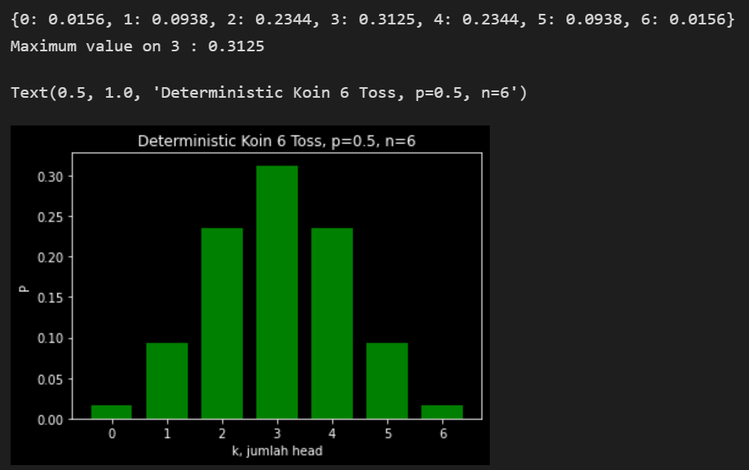

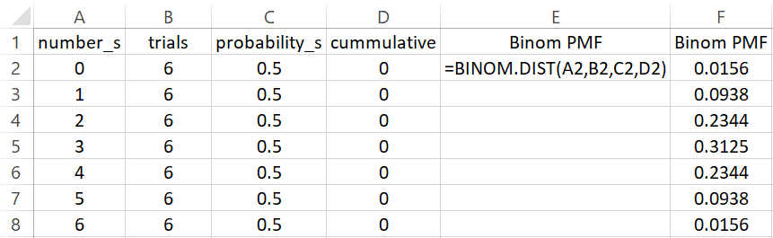
Binomial Probability Mass Function
Variasi Exactly Peluang Head pada 6 Kesempatan Toss Koin
 | Iteration Count: 100_000

Slide 6
Pascal’s Triangle
 |  |  |  |  |  | 1 |  |  |  |  |  |  |  | 1 |  |  |  |  |  |  |  | 1
 |  |  |  |  | 1 |  | 1 |  |  |  |  |  |  | 2 |  |  |  |  |  |  | 0.5 |  | 0.5
 |  |  |  | 1 |  | 2 |  | 1 |  |  |  |  |  | 4 |  |  |  |  |  | 0.25 |  | 0.5 |  | 0.25
 |  |  | 1 |  | 3 |  | 3 |  | 1 |  |  |  |  | 8 |  |  |  |  | 0.125 |  | 0.375 |  | 0.375 |  | 0.125
 |  | 1 |  | 4 |  | 6 |  | 4 |  | 1 |  |  |  | 16 |  |  |  | 0.0625 |  | 0.25 |  | 0.375 |  | 0.25 |  | 0.0625
 | 1 |  | 5 |  | 10 |  | 10 |  | 5 |  | 1 |  |  | 32 |  |  | 0.03125 |  | 0.15625 |  | 0.3125 |  | 0.3125 |  | 0.15625 |  | 0.03125
1 |  | 6 |  | 15 |  | 20 |  | 15 |  | 6 |  | 1 |  | 64 |  | 0.015625 |  | 0.09375 |  | 0.234375 |  | 0.3125 |  | 0.234375 |  | 0.09375 |  | 0.015625

Slide 7


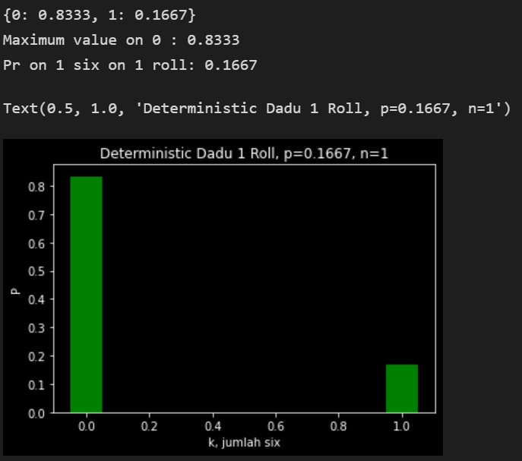
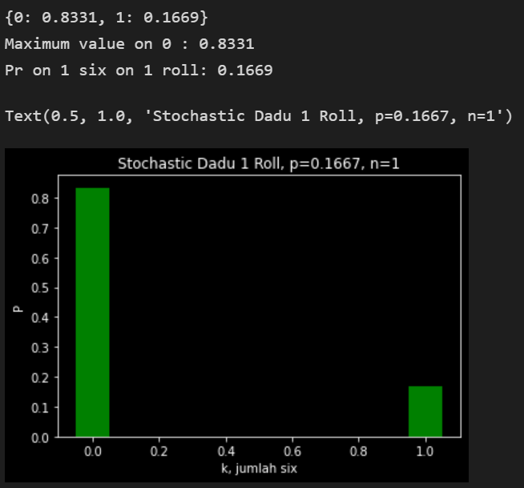
Binomial Probability Mass Function
number_s=k, trials=n, probability_s=p
Variasi Exactly Peluang “Enam” pada 1 Kesempatan Roll Dadu
 | Iteration Count: 100_000

Slide 8
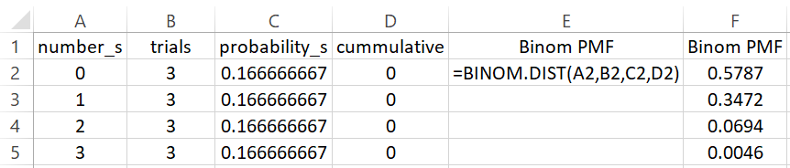
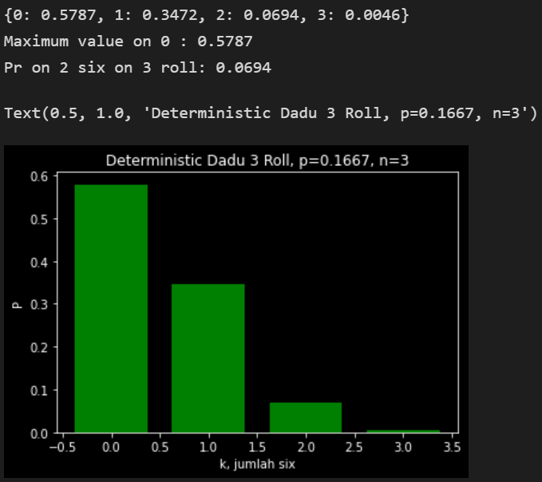
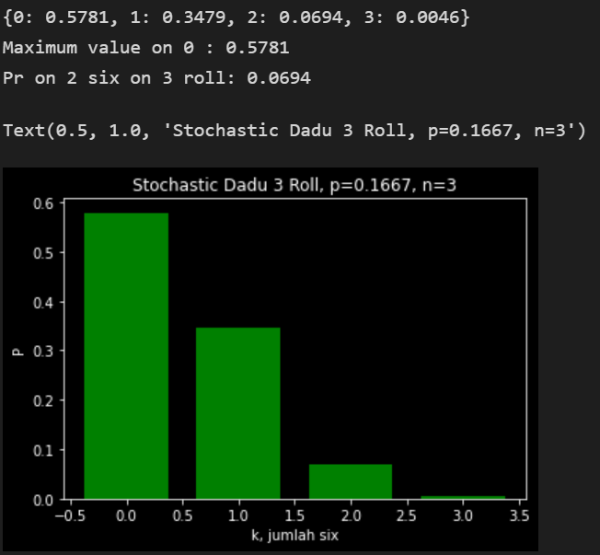
Binomial Probability Mass Function
number_s=k, trials=n, probability_s=p
Variasi Exactly Peluang “Enam” pada 3 Kesempatan Roll Dadu
 | Iteration Count: 100_000

Slide 9
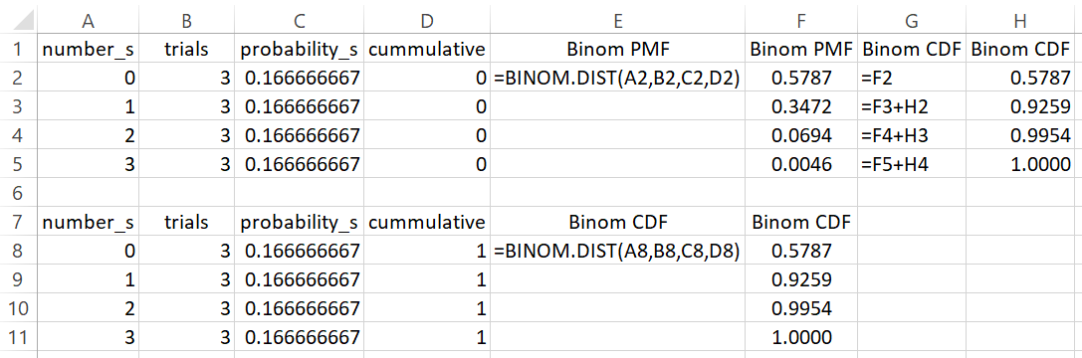
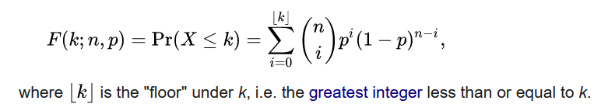
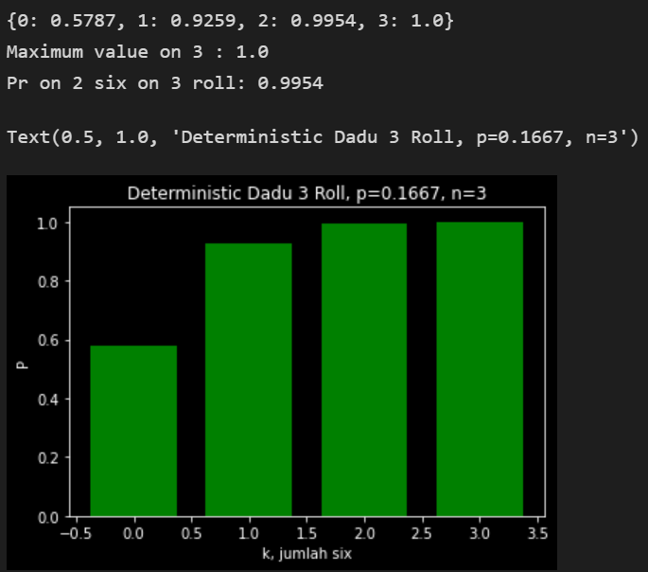
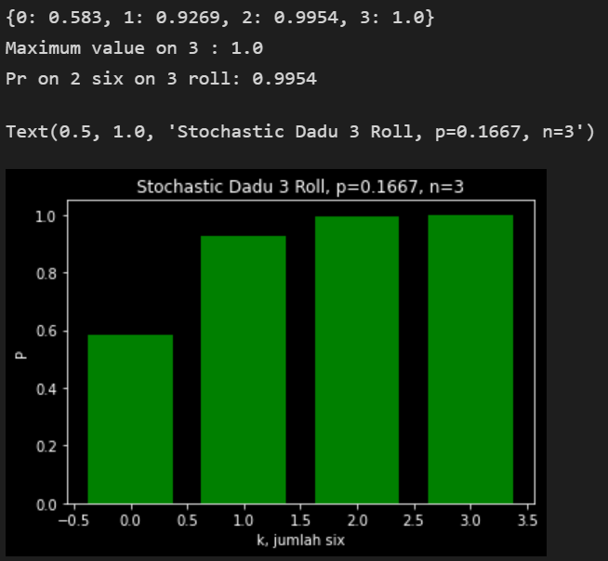
Binomial Cumulative Distribution Function
number_s=k, trials=n, probability_s=p
Variasi At Least Peluang “Enam” pada 3 Kesempatan Roll Dadu
 | Iteration Count: 100_000

Slide 10
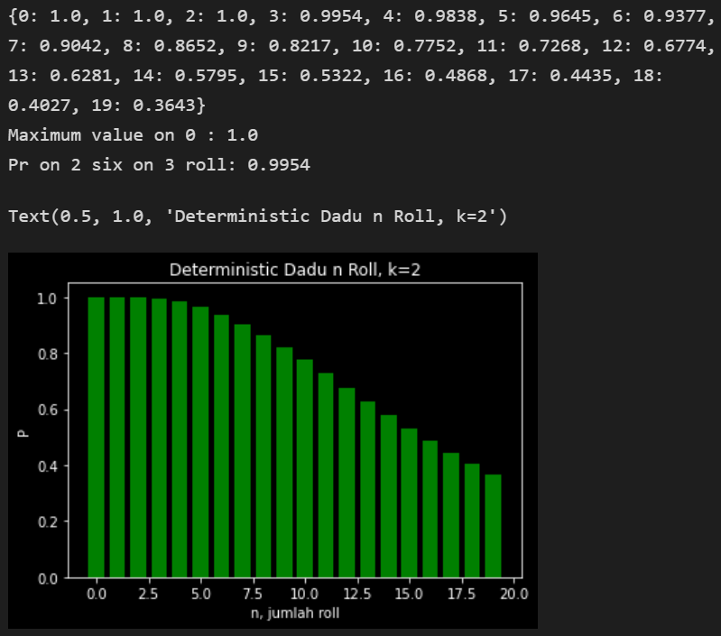
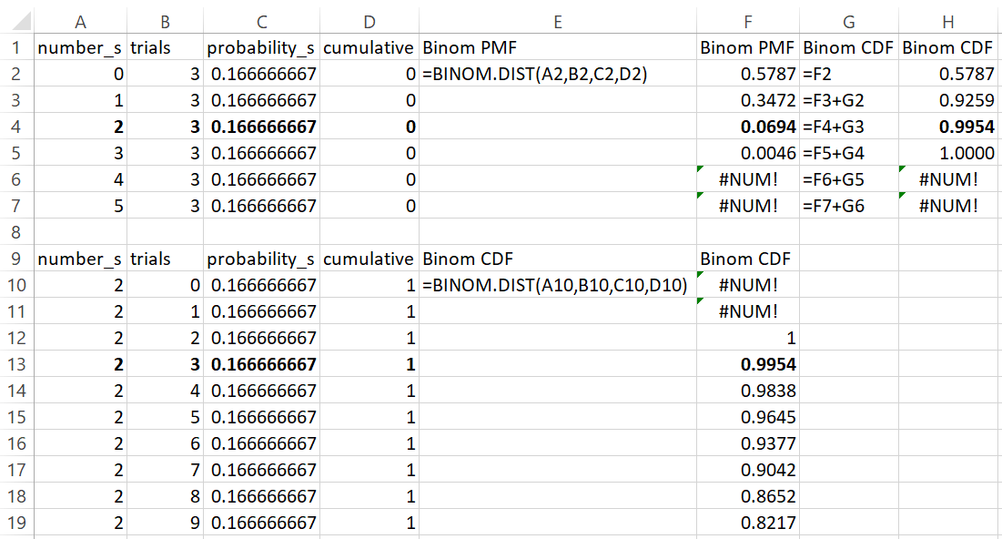
Binomial Cumulative Distribution Function
Peluang Muncul Maximum Dua “Enam” pada n Kesempatan Roll Dadu
 | number_s=k, trials=n, probability_s=p

Slide 11
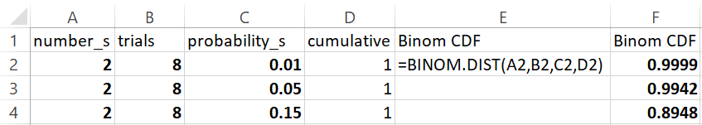
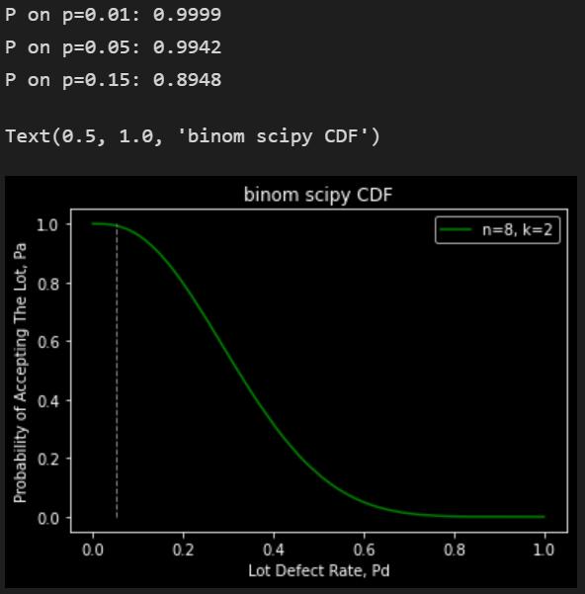
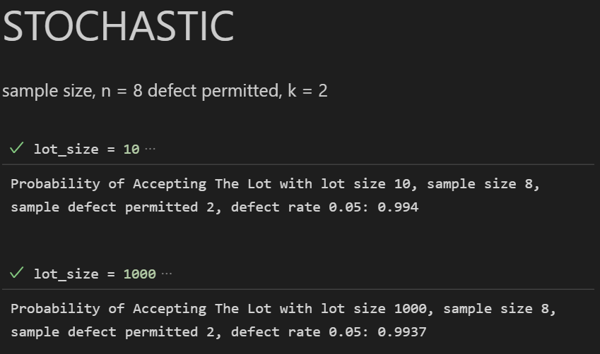
Binomial OC Curve
OC Curve n = 8 # jumlah sample dari lot, k = 2 # jumlah defects bisa diterima
 | Iteration Count: 100_000

Slide 12
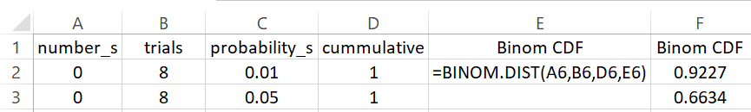
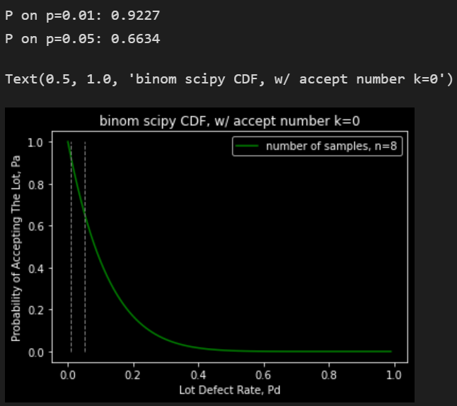
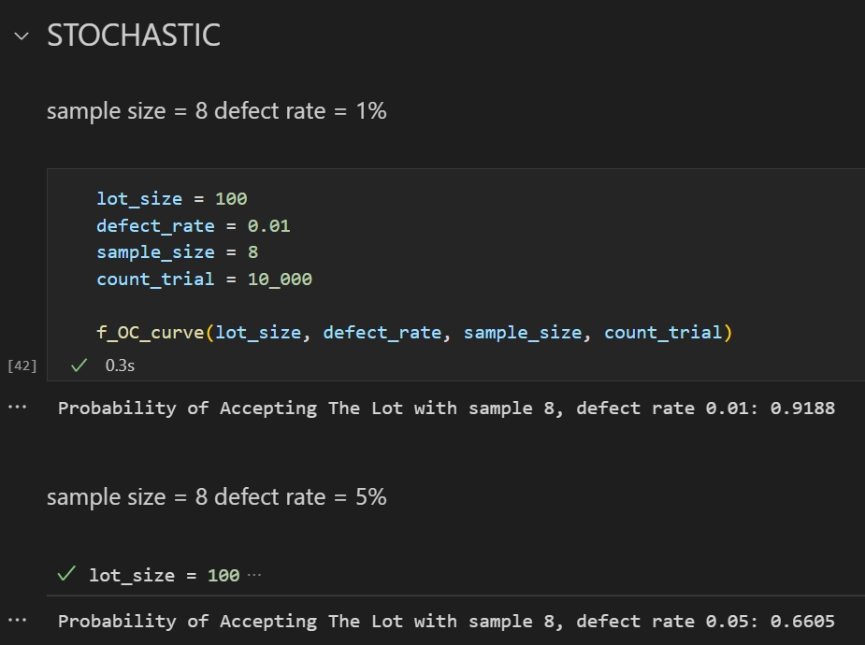
Binomial OC Curve
OC Curve n = 8 # jumlah sample dari lot, k = 0 # jumlah defects bisa diterima
 | Iteration Count: 100_000

Slide 13
Poisson

Slide 14
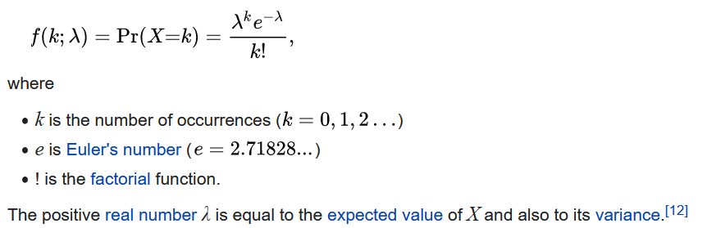
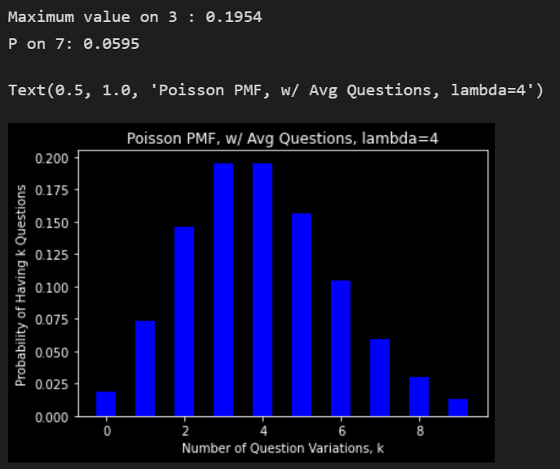
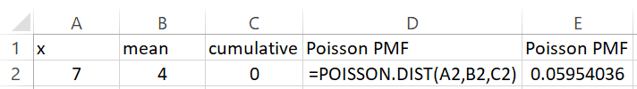

Poisson
Probability Mass Function
Average daily questions = 4, how likely to have exactly 7 questions? https://www.youtube.com/watch?v=BbLfV0wOeyc
 | x = k, mean = lambda

Slide 15
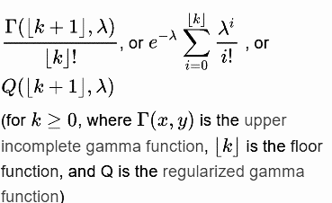
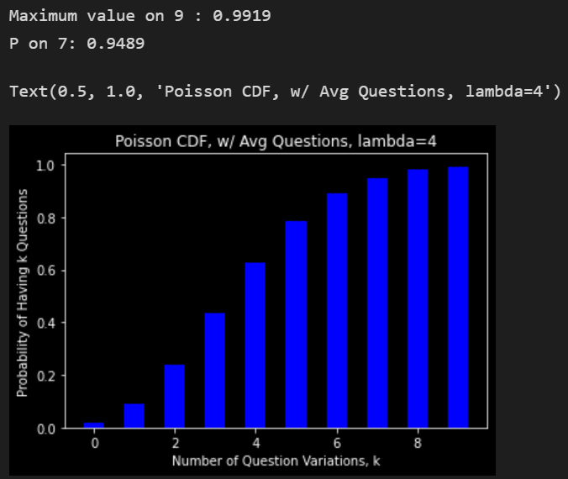
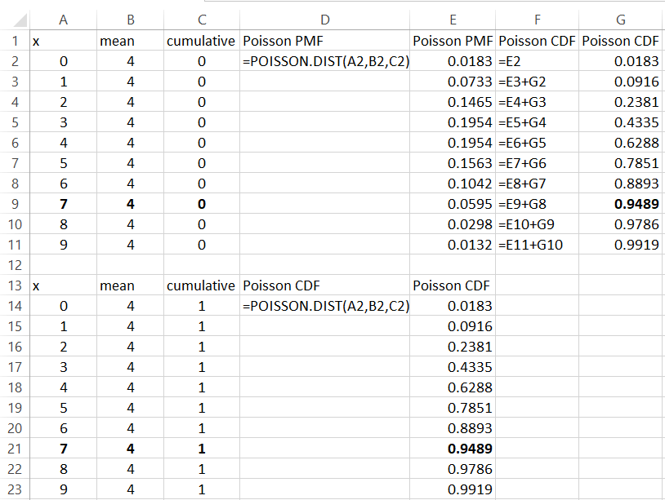
Poisson Cumulative Distribution Function
Average daily questions = 4, how likely to have maximum 7 questions? https://www.youtube.com/watch?v=BbLfV0wOeyc
 | x = k, mean = lambda

Slide 16
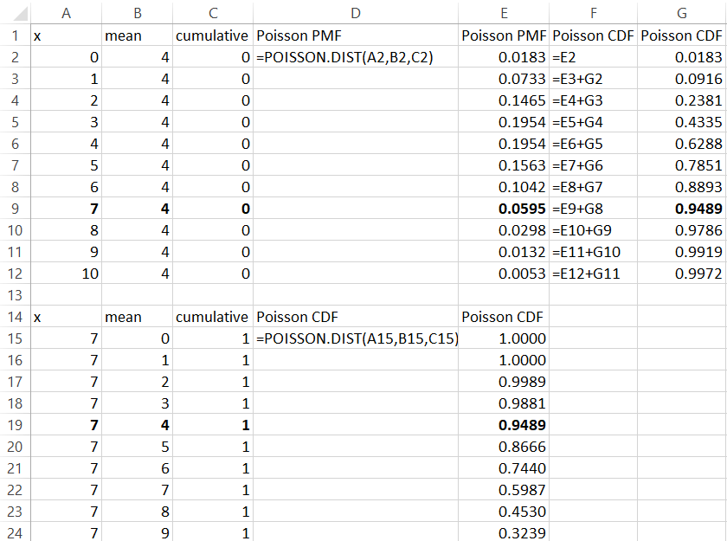
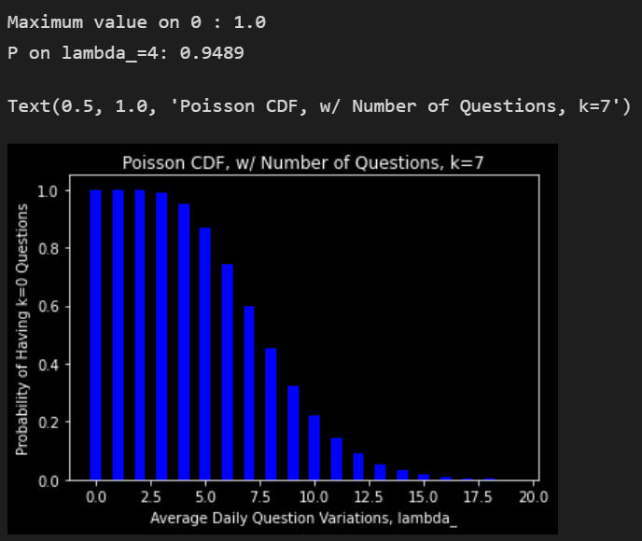
Poisson Cumulative Distribution Function
How likely to have maximum 7 questions, with various average daily questions?
 | x = k, mean = lambda

Slide 17
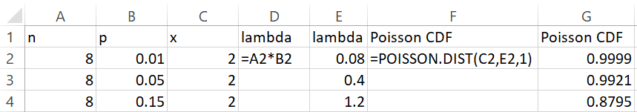
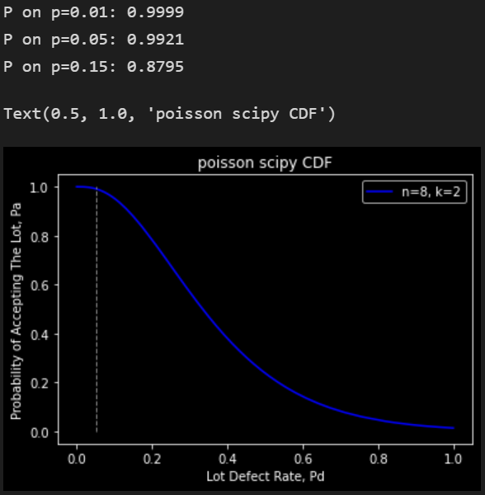
Poisson OC Curve
OC Curve n = 8 # jumlah sample dari lot, k = 2 # jumlah defects bisa diterima
 | Iteration Count: 100_000

Slide 18
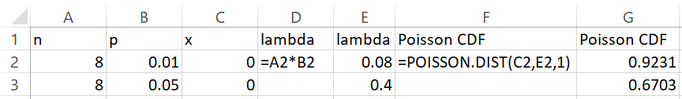
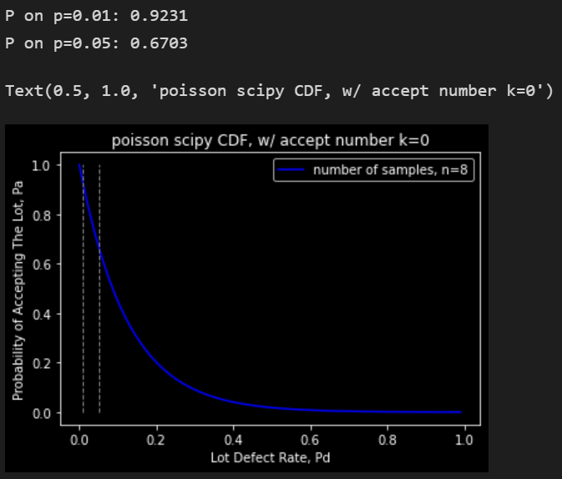
Poisson OC Curve
OC Curve n = 8 # jumlah sample dari lot, k = 0 # jumlah defects bisa diterima
 | Iteration Count: 100_000

Slide 19
OC Curve: Binomial vs Poisson vs Stochastic vs ANSI Tables

Slide 20
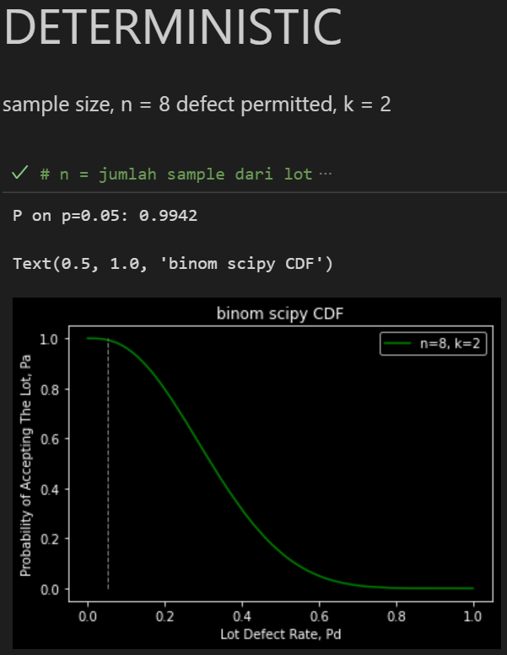
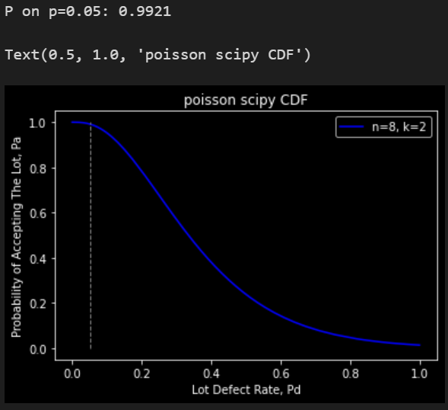
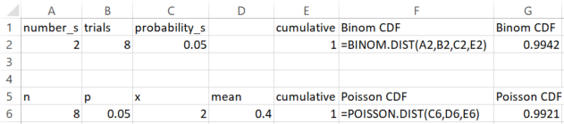

Slide 21


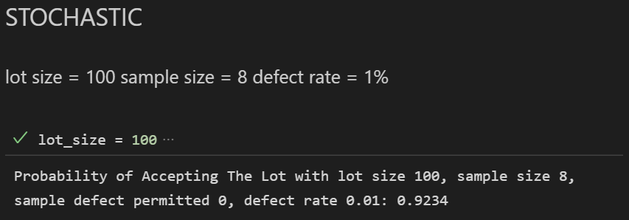
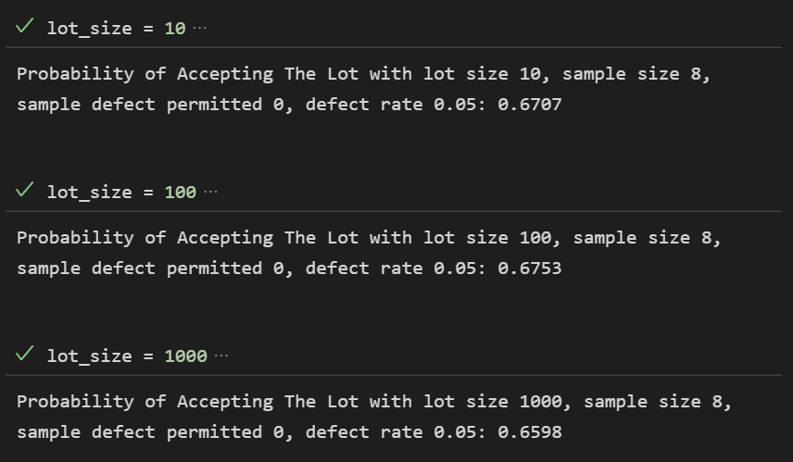

Slide 22
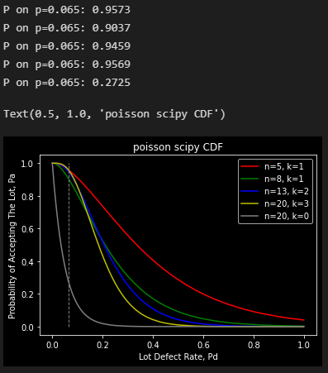
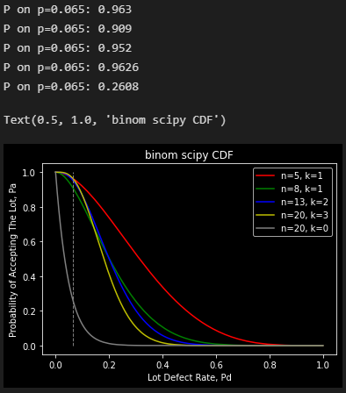

Slide 23
https://www.massey.ac.nz/~kgovinda/nzcodexdoc/index.html
Key definitions
The Operating Characteristic (OC) curve is a curve showing, for a given sampling plan, the probability of acceptance of a lot as a function of it’s actual quality.
Producer’s Risk is the probability of wrongly rejecting a compliant lot, with level of non-conformance at or below the acceptance quality limit (or proportion of non-conforming units for lots consisting of discrete items). Generally the quality of an acceptable lot is expressed as the Acceptance Quality Limit. It is a point on the OC curve corresponding to some predetermined and usually low probability of rejection. This probability of rejection is called the ‘producer’s risk’.
Consumers’ Risk is the probability of wrongly accepting a lot that is not of acceptable quality. It is a point on the OC curve corresponding to a predetermined and usually low probability of acceptance. This probability is then called the ‘consumer’s risk’ and the corresponding lot quality is called the Limiting Quality (LQ or LQL).
The Acceptance Quality Limit (AQL) (previously called Acceptable Quality Level) is the level of proportion of non-conforming items at which lots are accepted most of the time, usually taken as 95%.
The Limiting Quality (LQ or LQL) is the proportion of non-conforming items associated with the consumer’s risk, or the level of non-conforming items of lots accepted after control, in 10% of the cases.
 | Accept The Lot | Reject The Lot
Good Lot | No Error | Type I Error Producer’s Risk
Bad Lot | Type II Error Consumer’s Risk | No Error
 | Sampling Error

Slide 24
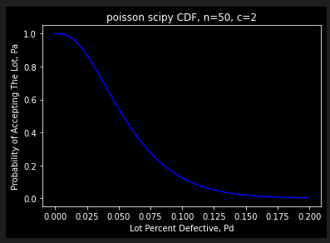
n | p | x | lambda | Poisson CDF
50 | 0.01 | 2 | 0.5 | 0.986
50 | 0.016361 | 2 | 0.818045 | 0.950
50 | 0.02 | 2 | 1 | 0.920
50 | 0.03 | 2 | 1.5 | 0.809
50 | 0.04 | 2 | 2 | 0.677
50 | 0.05 | 2 | 2.5 | 0.544
50 | 0.06 | 2 | 3 | 0.423
50 | 0.07 | 2 | 3.5 | 0.321
50 | 0.08 | 2 | 4 | 0.238
50 | 0.09 | 2 | 4.5 | 0.174
50 | 0.1 | 2 | 5 | 0.125
50 | 0.106405 | 2 | 5.320267 | 0.100
50 | 0.11 | 2 | 5.5 | 0.088
50 | 0.12 | 2 | 6 | 0.062
Producer’s Risk:
alpha = 0.05, AQL=1.64%
Consumer’s Risk:
beta = 0.1, LQ=10.64%

Slide 25
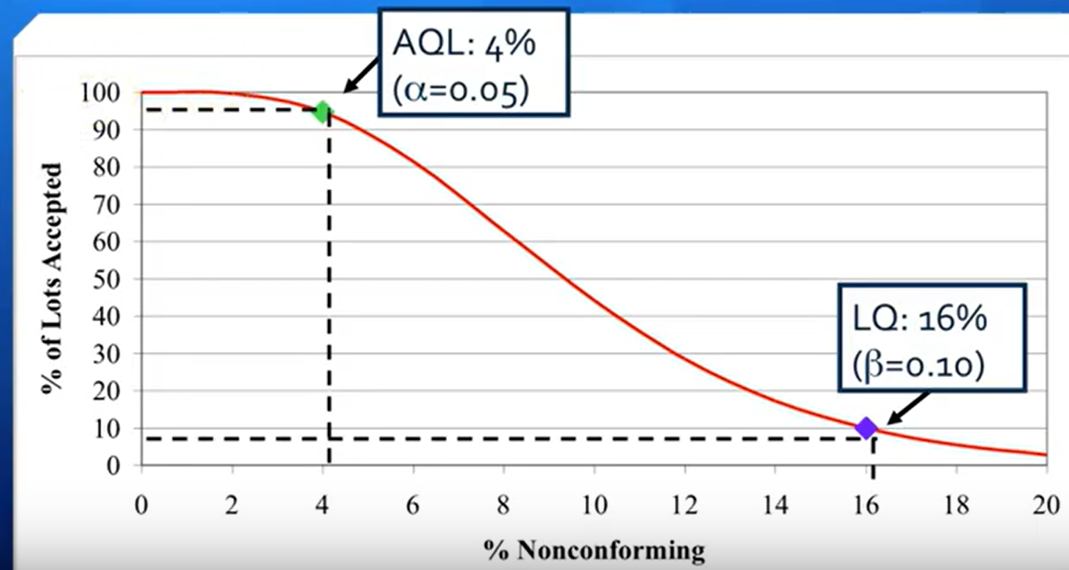
n | p | x | lambda | Poisson CDF
8 | 0.01 | 3 | 0.08 | 1.000
8 | 0.05 | 3 | 0.4 | 0.999
8 | 0.1 | 3 | 0.8 | 0.991
8 | 0.15 | 3 | 1.2 | 0.966
8 | 0.2 | 3 | 1.6 | 0.921
8 | 0.171581 | 3 | 1.3726 | 0.949
8 | 0.25 | 3 | 2 | 0.857
8 | 0.3 | 3 | 2.4 | 0.779
8 | 0.35 | 3 | 2.8 | 0.692
8 | 0.4 | 3 | 3.2 | 0.603
8 | 0.45 | 3 | 3.6 | 0.515
8 | 0.5 | 3 | 4 | 0.433
8 | 0.55 | 3 | 4.4 | 0.359
8 | 0.6 | 3 | 4.8 | 0.294
8 | 0.65 | 3 | 5.2 | 0.238
8 | 0.7 | 3 | 5.6 | 0.191
8 | 0.75 | 3 | 6 | 0.151
8 | 0.8 | 3 | 6.4 | 0.119
8 | 0.834984 | 3 | 6.6799 | 0.100
8 | 0.85 | 3 | 6.8 | 0.093
alpha = 0.05, AQL=0.172
beta = 0.1, LQ=0.835

